Slide 1
Data Science Salaries

Slide 2
Cleaning
The data included some duplicate values that I removed.
There were no null values, and there were no values in an incorrect column.
During some of the analysis, I grouped together some similar job titles like Machine Learning Engineer with ML Engineer

Slide 3
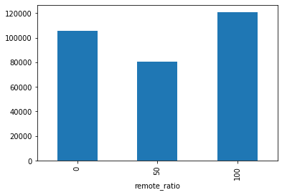
Jobs that are 100% remote appear have the highest income

Slide 4
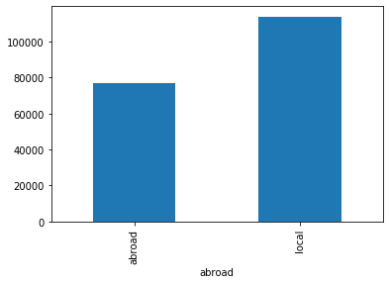
In what seems like a contradiction, jobs where the employee’s country differs from the company’s country have a lower average salary than when both are in the same place.
This can be because there are fewer jobs abroad so they don’t have much weighting on the total number of remote work jobs. More research would be required.

Slide 5
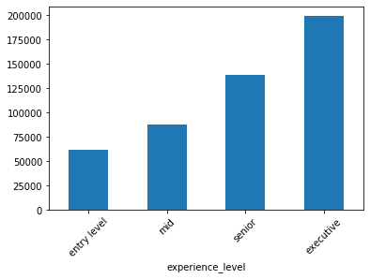
As expected, a higher experience level relates to a higher average salary

Slide 6
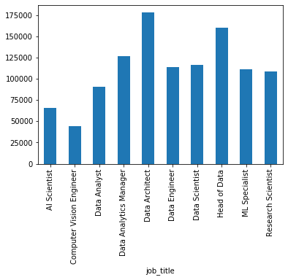
These are the average salaries of the top 10 most common jobs.
The highest paid is Data Architect, followed by Head of Data

